Slide 1
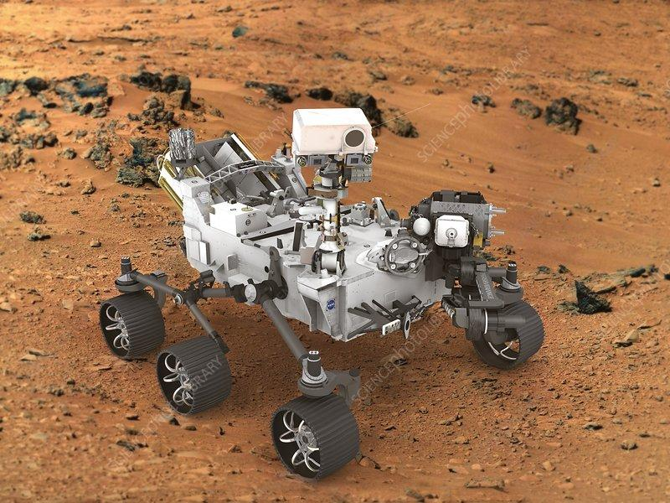
Jbot
By: Jonathan’s

Slide 2

Introduction
Idea
RC
Drive path
Forward
Reverse
Square
Triangle
Main goal
Drive path

Slide 3
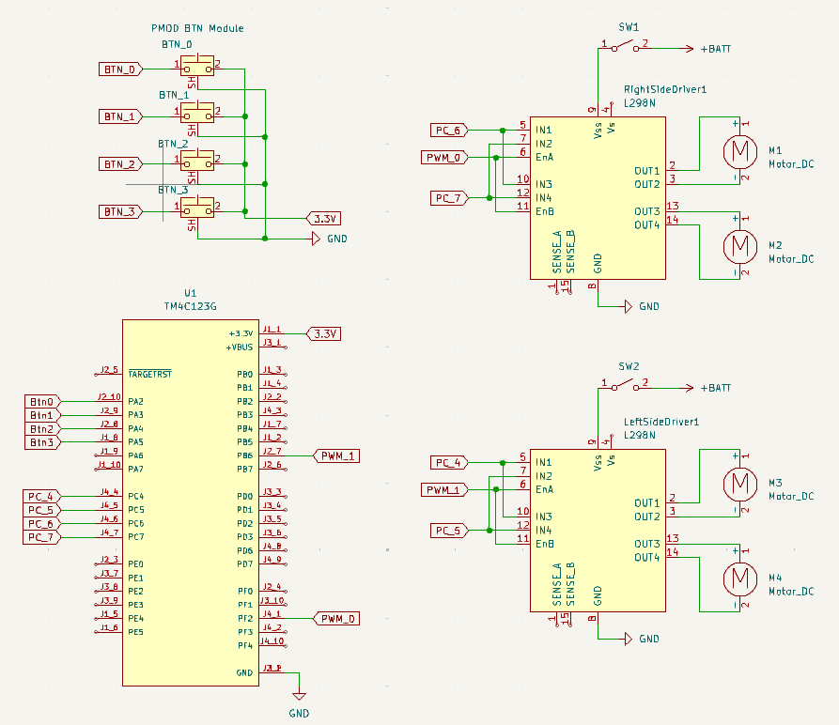
Full schematic

Slide 4

Software
Keil v5
Main
Main.c
SRC (C files)
SYSTICK.c
TIMER_0A_INTERUPT.c
GPIO.c
PWM0_0.c
PWM0_1.c
PMOD_BTN_INTERUPT.c
INC (header files)
SYSTICK.h
TIMER_0A_INTERUPT.h
GPIO.h
PWM0_0.h
PWM0_1.h
PMOD_BTN_INTERUPT.h

Slide 5
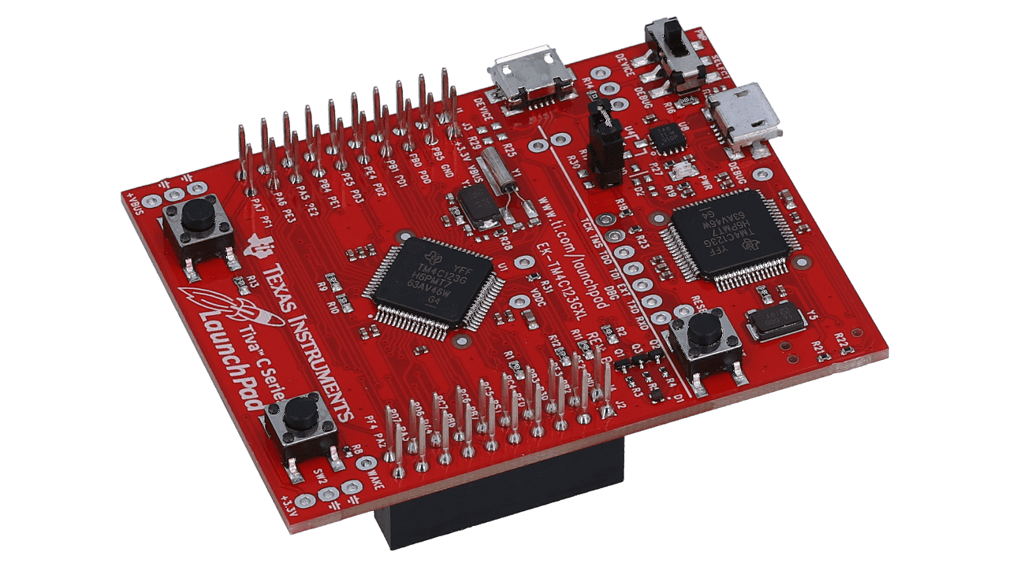
Main hardware
Tiva C Series TM4C123G
GPIO
Motor driver
Pmod
PWM
Duty cycle
Motors
Systick
Delays
Interrupts
Pmod

Slide 6
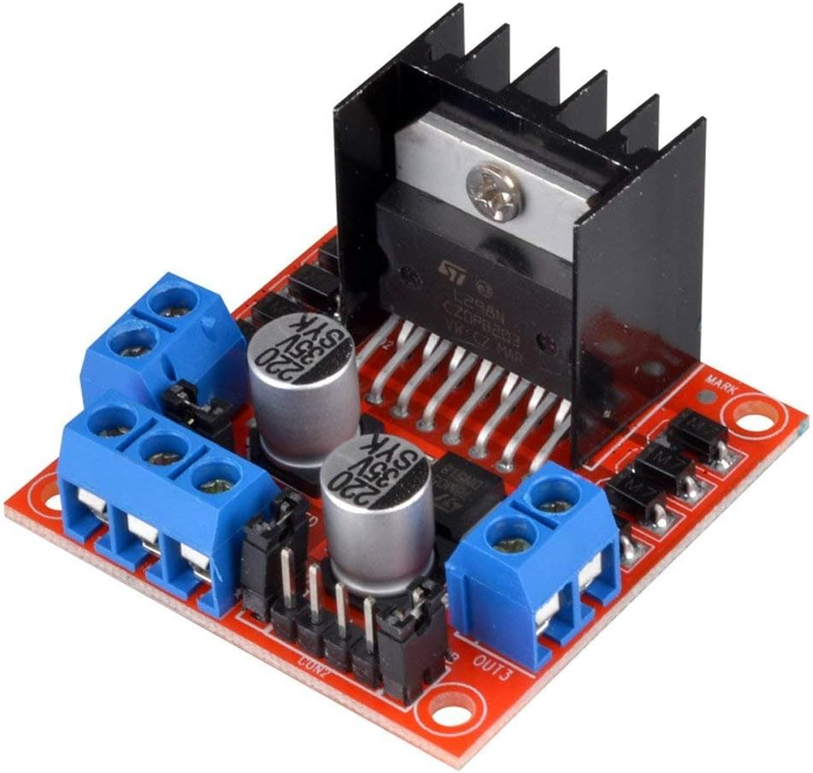
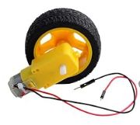
Main hardware
HiLetgo L298N Motor Driver
H Bridge
Pwm
9V
Geared DC Motors

Slide 7
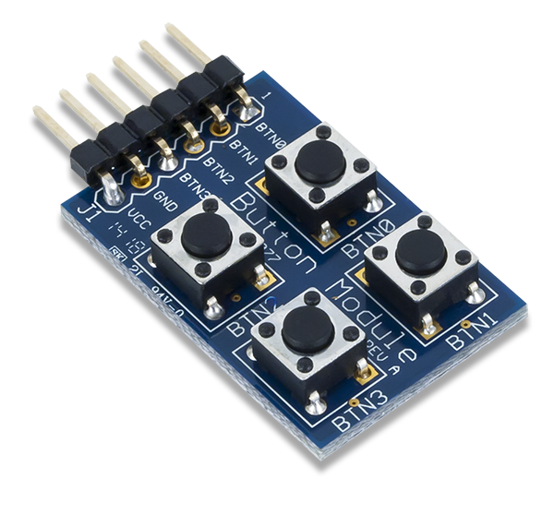
Main hardware
PMOD BTN Module
PMOD handler
Case 1 (BTN_0)
Forward
Case 2 (BTN_1)
Reverse
Case 3 (BTN_2)
Square path
Case 4 (BTN_3)
Triangle

Slide 8
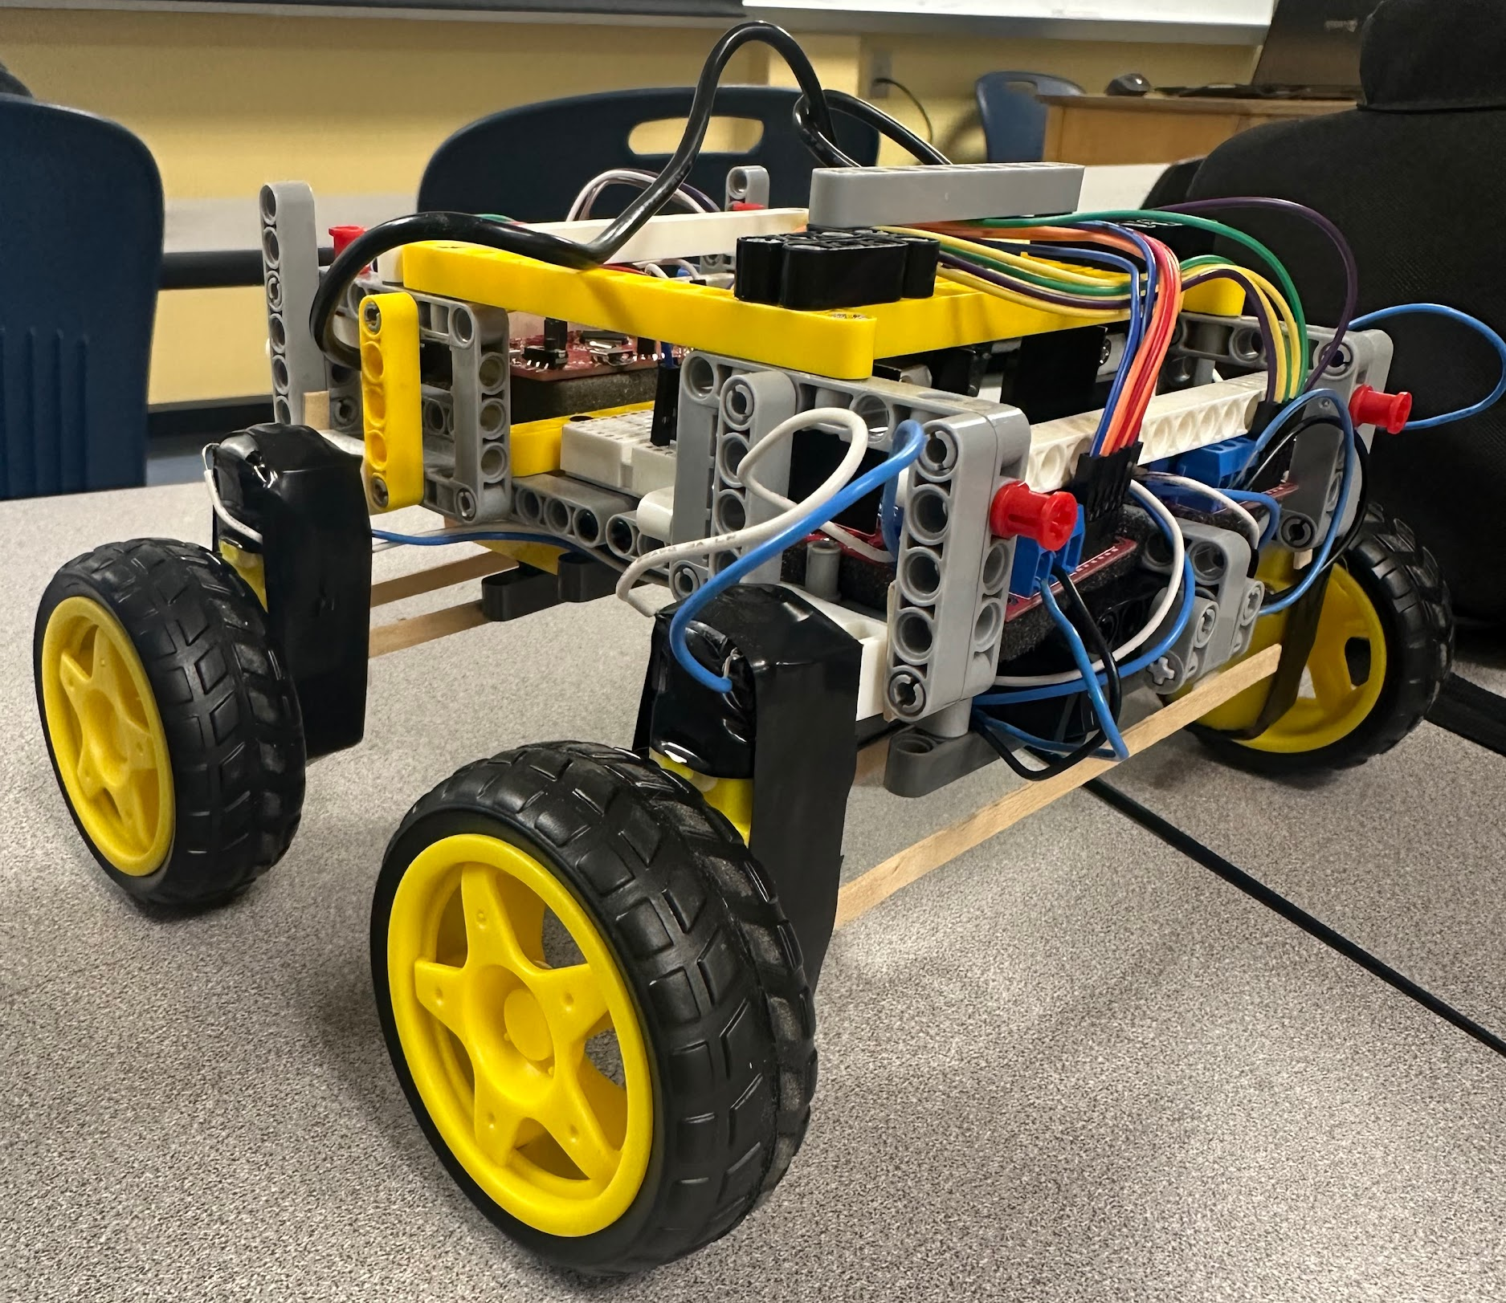
Results
Final design
Forward
Reverse
Square
Triangle
SPAZZZ

Slide 9

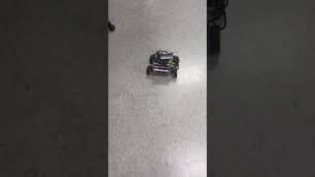
Forward
Reverse
Forward motion
Reverse motion

Slide 10
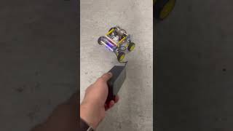
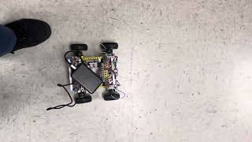
Square
Triangle
Square motion
Triangle motion

Slide 11
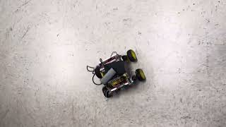
Random Path(SPAZZ)
Random motion( spazz)

Slide 12
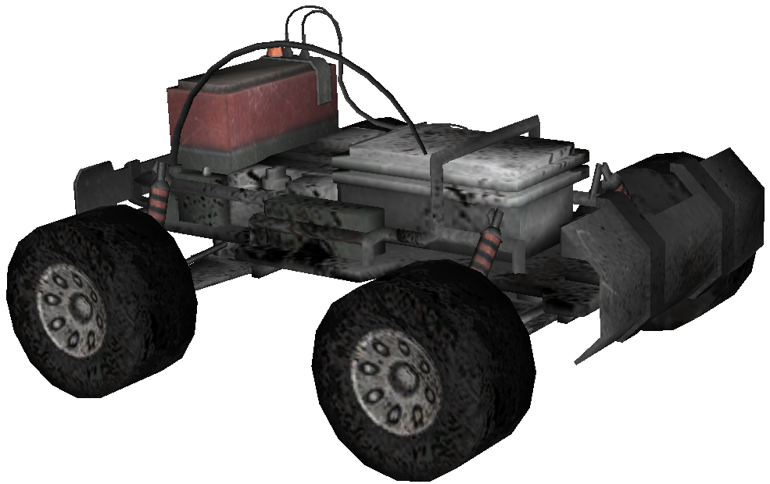
Possible improvements
Rc
Servo turning
Better power management
Independent PWM signal per motor

Slide 13
Component list
Description | Quantity | Manufacture
Tiva C series TM4C123G launchpad | 1 | Texas instrument
USB-A to Micro-USB cable | 1 | N/A
PMOD BTN Module | 1 | Digilent
Geared DC Motors | 4 | Gibildet
L298N dual DC motor driver | 2 | HiLetgo
Tires | 4 | Gibildet
9v battery | 2 | N/A
9v battery hardness | 2 | N/A
Lego Technic | 1 | Lego
Switches | 2 | N/A
Bread board | 1 | N/A

Slide 14
Pinout diagram lists
PMOD BTN Module
TM4C123G Launchpad | Pin purpose
PA2 | BTN_0
PA3 | BTN_1
PA4 | BTN_2
PA5 | BTN_3
VCC (3.3V) | VCC
GND | GND
L298N dual DC motor drivers
TM4C123G Launchpad | Pin purpose
PC4 | Input 1,3 Driver L
PC5 | Input 2,4 Driver L
PC6 | Input 1,3 Driver R
PC7 | Input 2,4 Driver R
PB6 | PWM_0
PF2 | PWM_1

Slide 15
Conclusion

